Slide 1
Validation of specifications

Slide 2
`
Switch off mobile phones during lectures, or put them into silent mode

Slide 3

Please Obey Traffic Signals

Slide 4


Slide 5

Keep Your Surrounding clean

Slide 6

Give Way to Ambulance because its destination is more important than yours

Slide 7

Save Water, Save life! The World is in Your Hands

Slide 8

CONTRIBUTE TO SOCIETY

Slide 9
Requirements analysis & system specifications
First, the statement of requirements should be simplified.
Second, any contradictions are removed.
Third, any ambiguities should be made precise and the system specification validated with the customer.
The system specification so formed should be precise and concise.

Slide 10
Steps to systems’ specifications
First, expressing parts of a system specification in propositional calculus will always condense the specification. Simplification can be achieved by applying a series of simplification rules in the same way that algebraic simplification rules can be used to simplify an expression.
Second, propositional calculus allows contradictions to be removed.
Third, propositional calculus enables ambiguities to be clarified and removed.

Slide 11
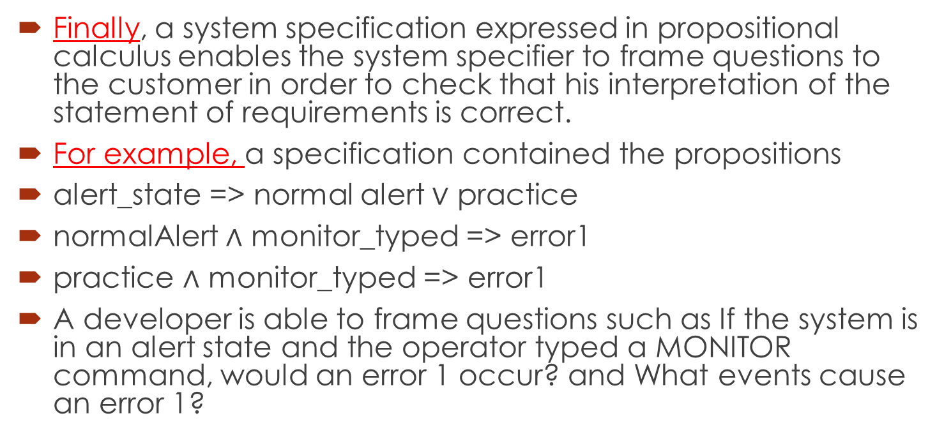
Finally, a system specification expressed in propositional calculus enables the system specifier to frame questions to the customer in order to check that his interpretation of the statement of requirements is correct.
For example, a specification contained the propositions
alert_state => normal alert $∨$ practice
normalAlert $∧$ monitor_typed => error1
practice $∧$ monitor_typed => error1
A developer is able to frame questions such as If the system is in an alert state and the operator typed a MONITOR command, would an error 1 occur? and What events cause an error 1?

Slide 12

VALID AND INVALID ARGUMENT
An argument is valid if the conclusion is true when all the premises are true.
Alternatively, an argument is valid if conjunction of its premises imply conclusion.
That is (P₁∧ P₂ ∧ P₃ ∧ . . . ∧ P_{n}) C is a tautology.
An argument is invalid if the conclusion is false when all the premises are true.
Alternatively, an argument is invalid if conjunction of its premises does not imply conclusion.
$$⊢$$

Slide 13
EXAMPLE
Show that the following argument form is valid:
p → q
p
∴ q
SOLUTION
We will construct the truth table for premise and the conclusion.
Now first row is such that both the premises have truth value T and hence that row is the critical row and the conclusion also have truth value T so the argument is valid.
p | q | p→q | p | q
T | T | T | T | T
T | F | F | T | F
F | T | T | F | T
F | F | T | F | F
Critical row

Slide 14
EXERCISE Show that the following argument form is invalid: p→q q ∴ p SOLUTION First of all we will construct the truth table for premises and conclusion.
p | q | p→q | q | p
T | T | T | T | T
T | F | F | F | T
F | T | T | T | F
F | F | T | F | F
Critical row
Critical row
Now in the above table first and third rows are critical because both of our premises are true in these rows. But the argument is invalid because in the third row our conclusion is false.

Slide 15
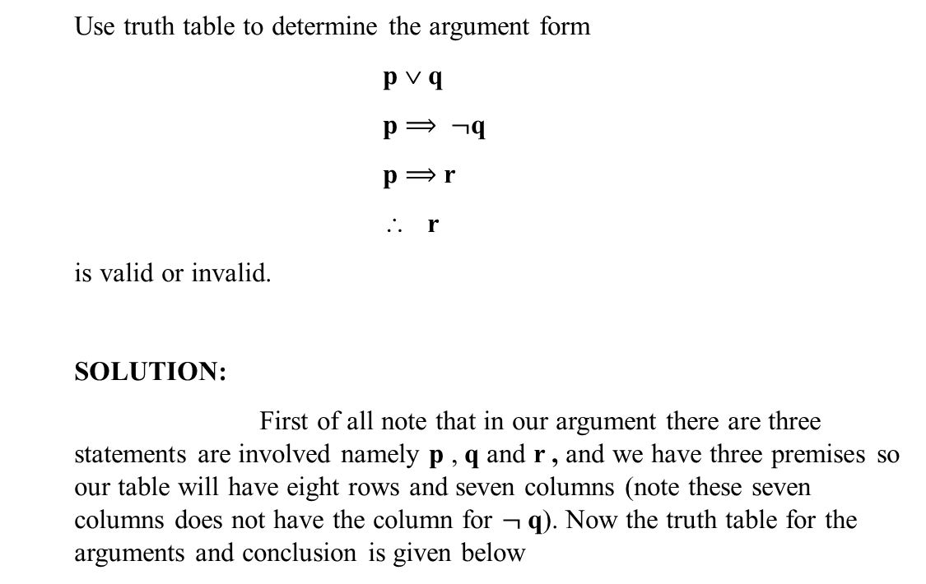
EXAMPLE
Use truth table to determine the argument form
p ∨ q
p $⟹$ $¬$q
p $⟹$ r
∴ r
is valid or invalid.
SOLUTION:
First of all note that in our argument there are three statements are involved namely p , q and r , and we have three premises so our table will have eight rows and seven columns (note these seven columns does not have the column for $¬$q). Now the truth table for the arguments and conclusion is given below

Slide 16
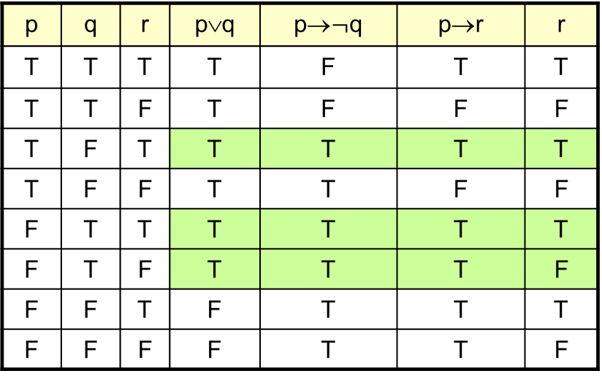
p | q | r | p∨q | p→$¬$q | p→r | r
T | T | T | T | F | T | T
T | T | F | T | F | F | F
T | F | T | T | T | T | T
T | F | F | T | T | F | F
F | T | T | T | T | T | T
F | T | F | T | T | T | F
F | F | T | F | T | T | T
F | F | F | F | T | T | F
Critical row
In the above table, we note that there are three critical rows and the conclusion has truth value T in one critical row consequently our argument is invalid

Slide 17
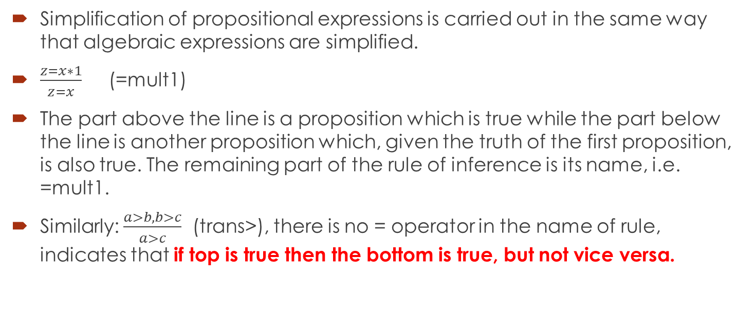
simplification
Simplification of propositional expressions is carried out in the same way that algebraic expressions are simplified.
$\frac{z=x∗1}{z=x}$ (=mult1)
The part above the line is a proposition which is true while the part below the line is another proposition which, given the truth of the first proposition, is also true. The remaining part of the rule of inference is its name, i.e. =mult1.
Similarly: $\frac{a>b, b>c}{a>c}$ (trans>), there is no = operator in the name of rule, indicates that if top is true then the bottom is true, but not vice versa.

Slide 18
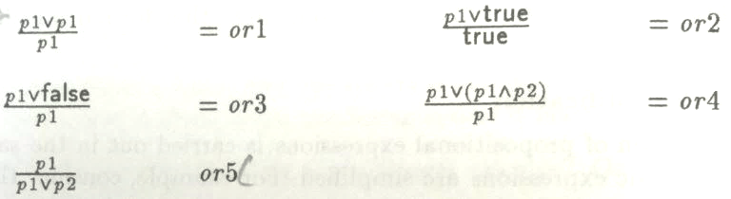
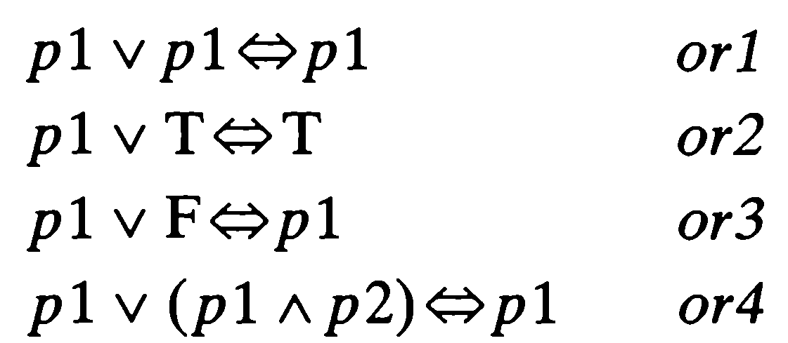


The laws of “or” simplification
OR

Slide 19
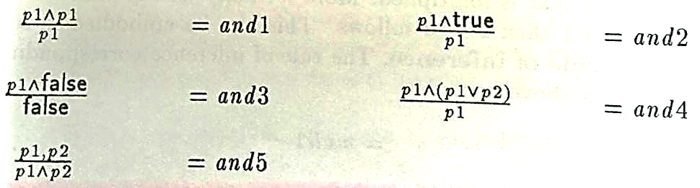
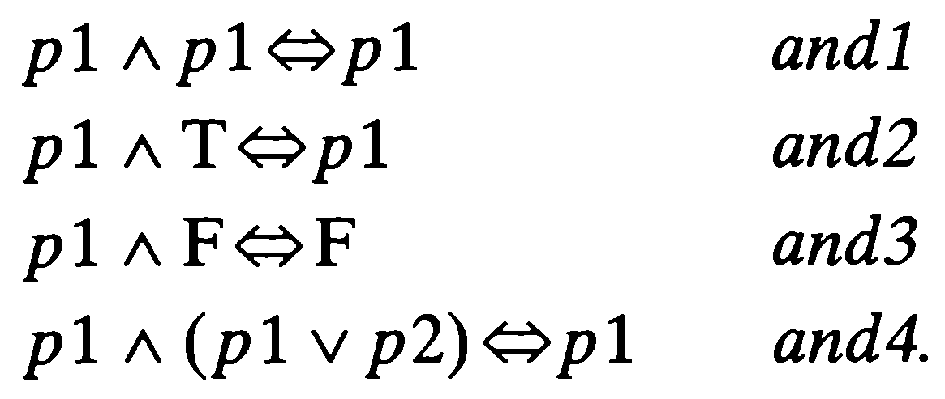
The laws of AND simplification
OR

Slide 20
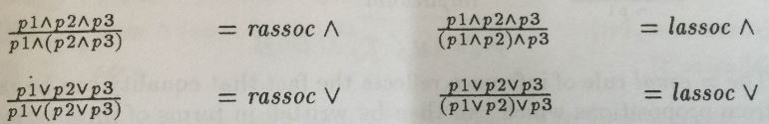


Slide 21
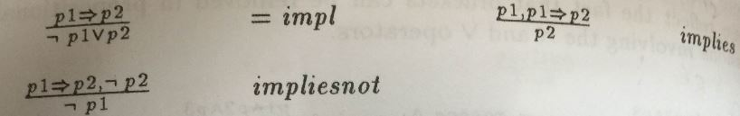
Distributive and implication
Implies also known as Modus Ponens and impliesnot also known as Modus Tollens

Slide 22



The law of Equivalent

Slide 23
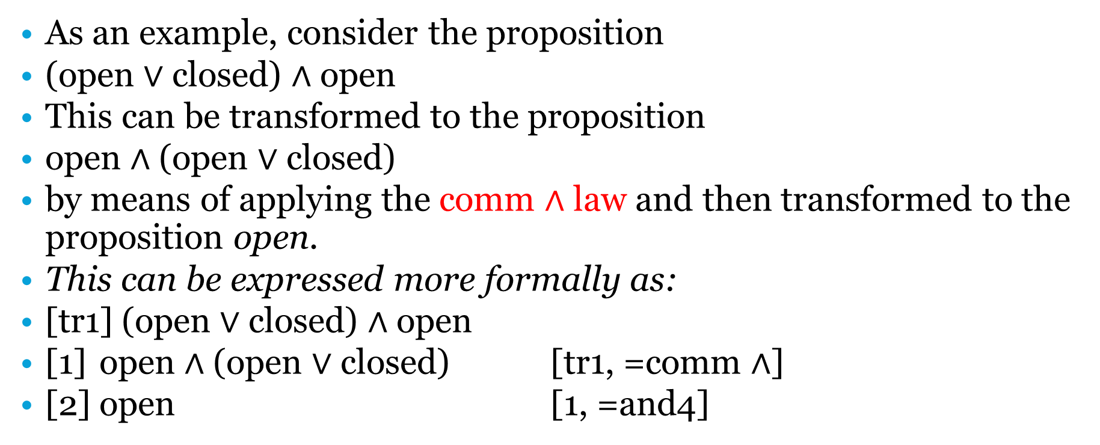
Example of simplification
As an example, consider the proposition
(open $∨$ closed) $∧$ open
This can be transformed to the proposition
open $∧$ (open $∨$ closed)
by means of applying the comm $∧$ law and then transformed to the proposition open.
This can be expressed more formally as:
[tr1] (open $∨$ closed) $∧$ open
[1] open $∧$ (open $∨$ closed) [tr1, =comm $∧$]
[2] open [1, =and4]

Slide 24
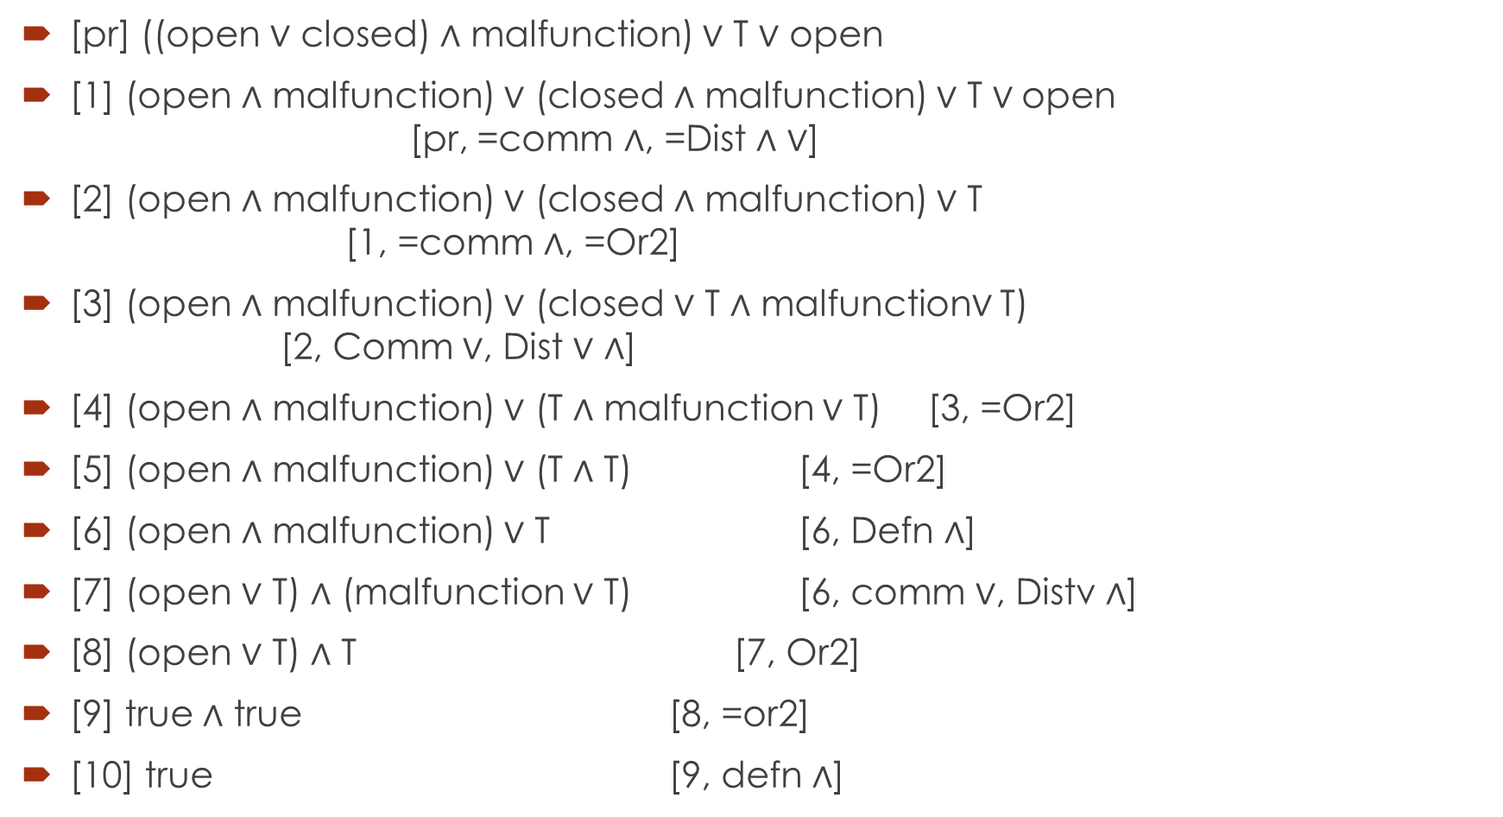
Complex example of simplification
[pr] ((open $∨$ closed) $∧$ malfunction) $∨$ T $∨$ open
[1] (open $∧$ malfunction) $∨$ (closed $∧$ malfunction) $∨$ T $∨$open [pr, =comm $∧$, =Dist $∧$ $∨$]
[2] (open $∧$ malfunction) $∨$ (closed $∧$ malfunction) $∨$ T [1, =comm $∧$, =Or2]
[3] (open $∧$ malfunction) $∨$ (closed $∨$ T $∧$ malfunction$∨$ T) [2, Comm $∨$, Dist $∨$ $∧$]
[4] (open $∧$ malfunction) $∨$ (T $∧$ malfunction $∨$ T) [3, =Or2]
[5] (open $∧$ malfunction) $∨$ (T $∧$ T) [4, =Or2]
[6] (open $∧$ malfunction) $∨$ T [6, Defn $∧$]
[7] (open $∨$ T) $∧$ (malfunction $∨$ T) [6, comm $∨$, Distv $∧$]
[8] (open $∨$ T) $∧$ T [7, Or2]
[9] true $∧$ true [8, =or2]
[10] true [9, defn $∧$]

Slide 25
Rules of inference for simplification of specifications
We have seen how the laws presented allow propositional expressions to be simplified.
You will find that system specifications and statements of requirements will contain a large number of fragments where simplification can make the meaning of natural-language statements clearer.

Slide 26
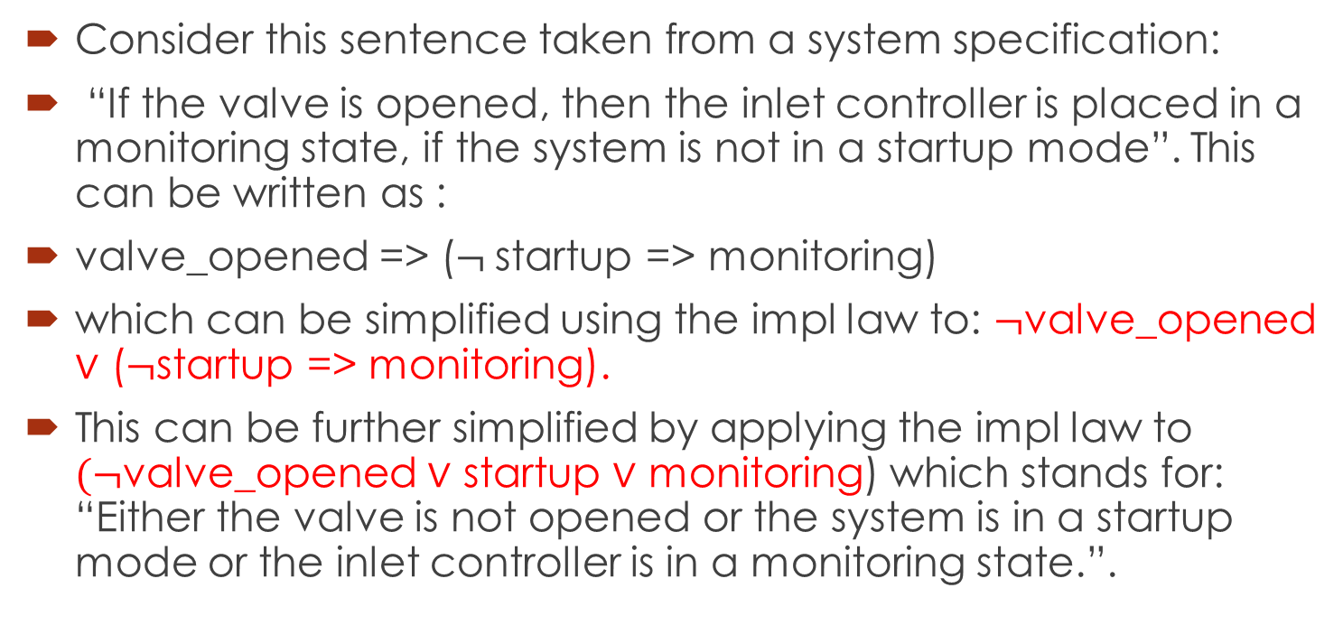
Example
Consider this sentence taken from a system specification:
“If the valve is opened, then the inlet controller is placed in a monitoring state, if the system is not in a startup mode”. This can be written as :
valve_opened => ($¬$startup => monitoring)
which can be simplified using the impl law to: $¬$valve_opened $∨$ ($¬$startup => monitoring).
This can be further simplified by applying the impl law to $(¬$valve_opened $∨$ startup $∨$ monitoring) which stands for: “Either the valve is not opened or the system is in a startup mode or the inlet controller is in a monitoring state.”.

Slide 27
Example
Express the following statements in propositional logic and derive the relationships between the monitoring state, the test state, and the fact that the reactor is operating.
The reactor is either in the monitoring or test state. It cannot be in both states. The reactor is functioning normally only when it is in one of these states.
If a reactor is functioning normally and is not in the test state then the reactor can be regarded as being operating.

Slide 28
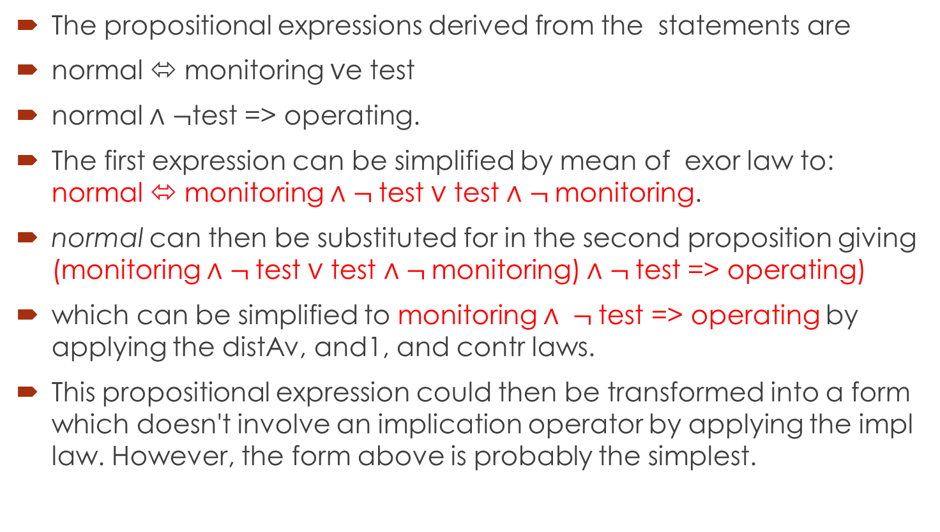
Solution
The propositional expressions derived from the statements are
normal ⬄ monitoring $∨$e test
normal $∧$ $¬$test => operating.
The first expression can be simplified by mean of exor law to: normal ⬄ monitoring $∧$ $¬$test $∨$ test $∧$ $¬$monitoring.
normal can then be substituted for in the second proposition giving (monitoring $∧$ $¬$test $∨$ test $∧$ $¬$monitoring) $∧$ $¬$test => operating)
which can be simplified to monitoring $∧$ $¬$test => operating by applying the distAv, and1, and contr laws.
This propositional expression could then be transformed into a form which doesn't involve an implication operator by applying the impl law. However, the form above is probably the simplest.

Slide 29
Reasoning
During the process of requirements analysis and specification, development staff ask questions.
One aspect of reasoning involves the identification of a set of premises and a conclusion and then showing that the conclusion logically follows from the premises. For example:
reactor in a ready state,
update command is typed,
data-base is empty,
query command is typed,
page break occurs,
chapter break occurs.

Slide 30
Examples of conclusions taken from the questions above are:
reactor is not in a ready state,
error message is displayed,
formatter ejects a new page.

Slide 31
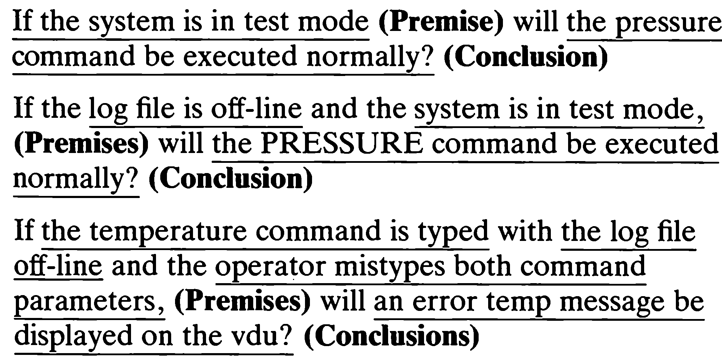
Given this specification a number of questions can be asked involving premises and conclusions. A sample is shown below:

Slide 32
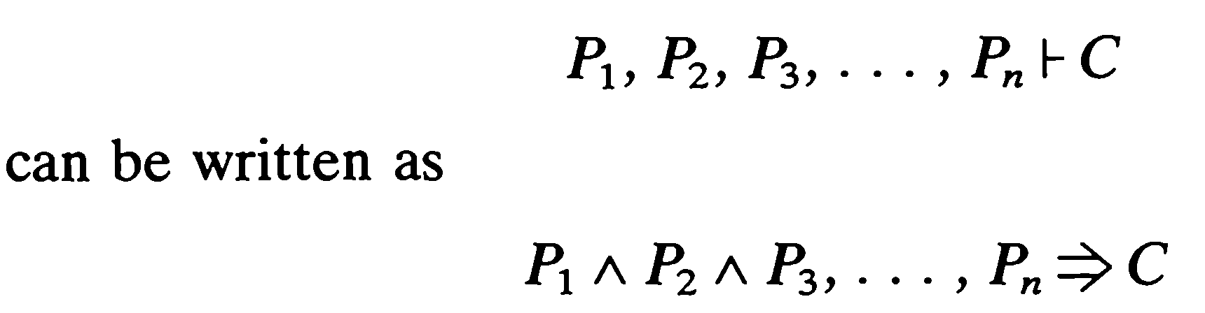
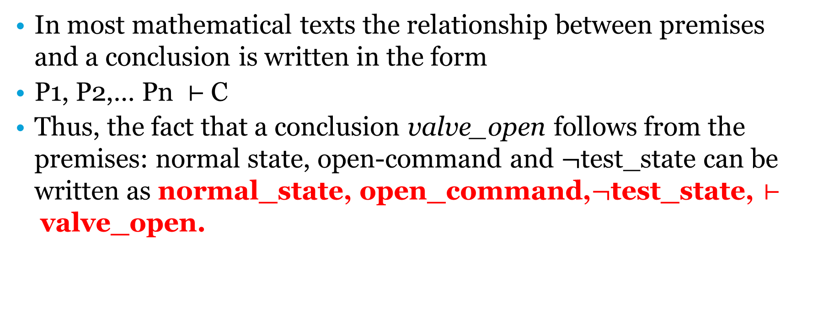
In most mathematical texts the relationship between premises and a conclusion is written in the form
P1, P2,… Pn $⊢$C
Thus, the fact that a conclusion valve_open follows from the premises: normal state, open-command and $¬$test_state can be written as normal_state, open_command,$¬$test_state, $⊢$valve_open.

Slide 33
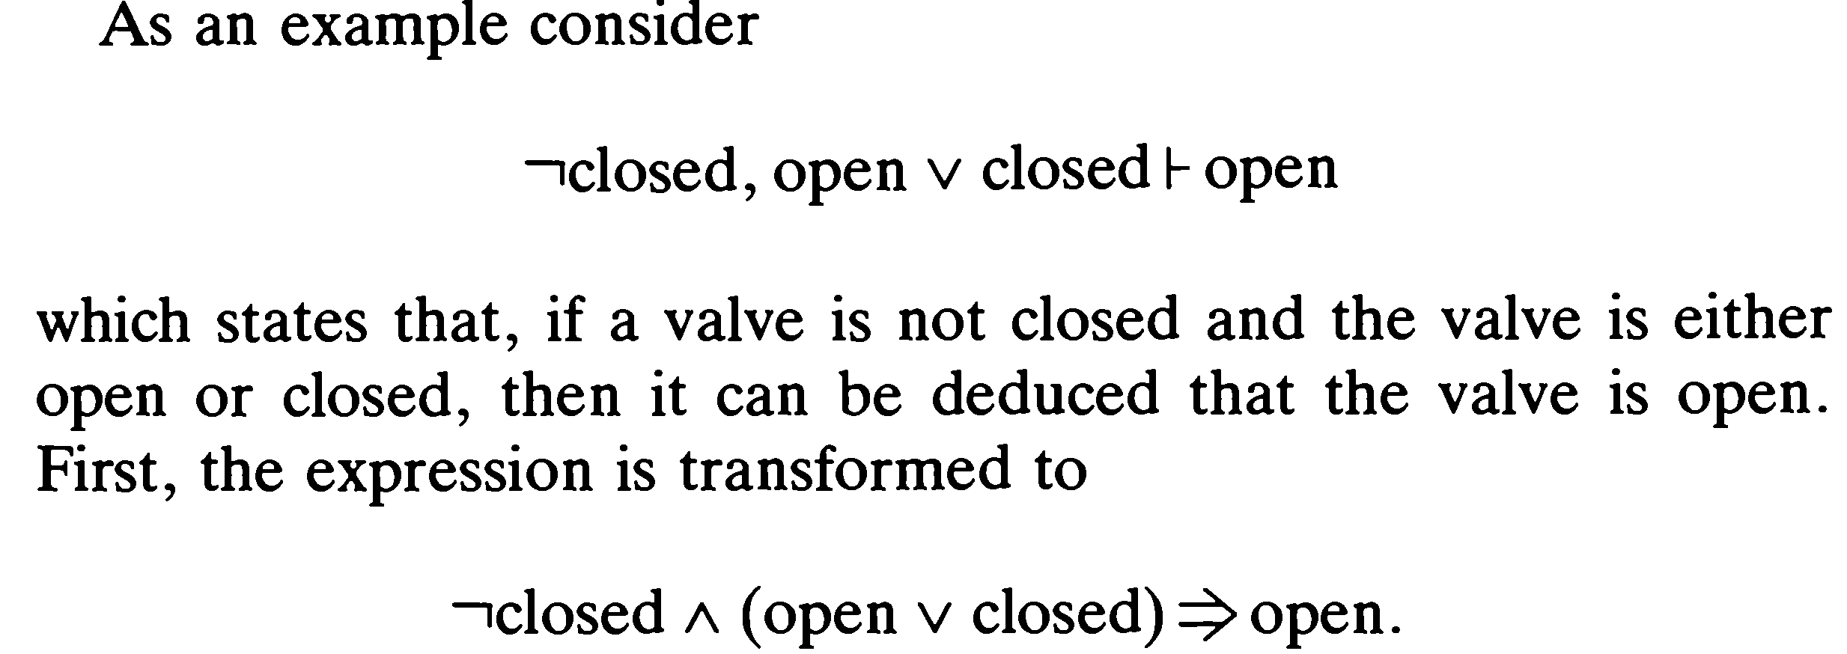

Slide 34
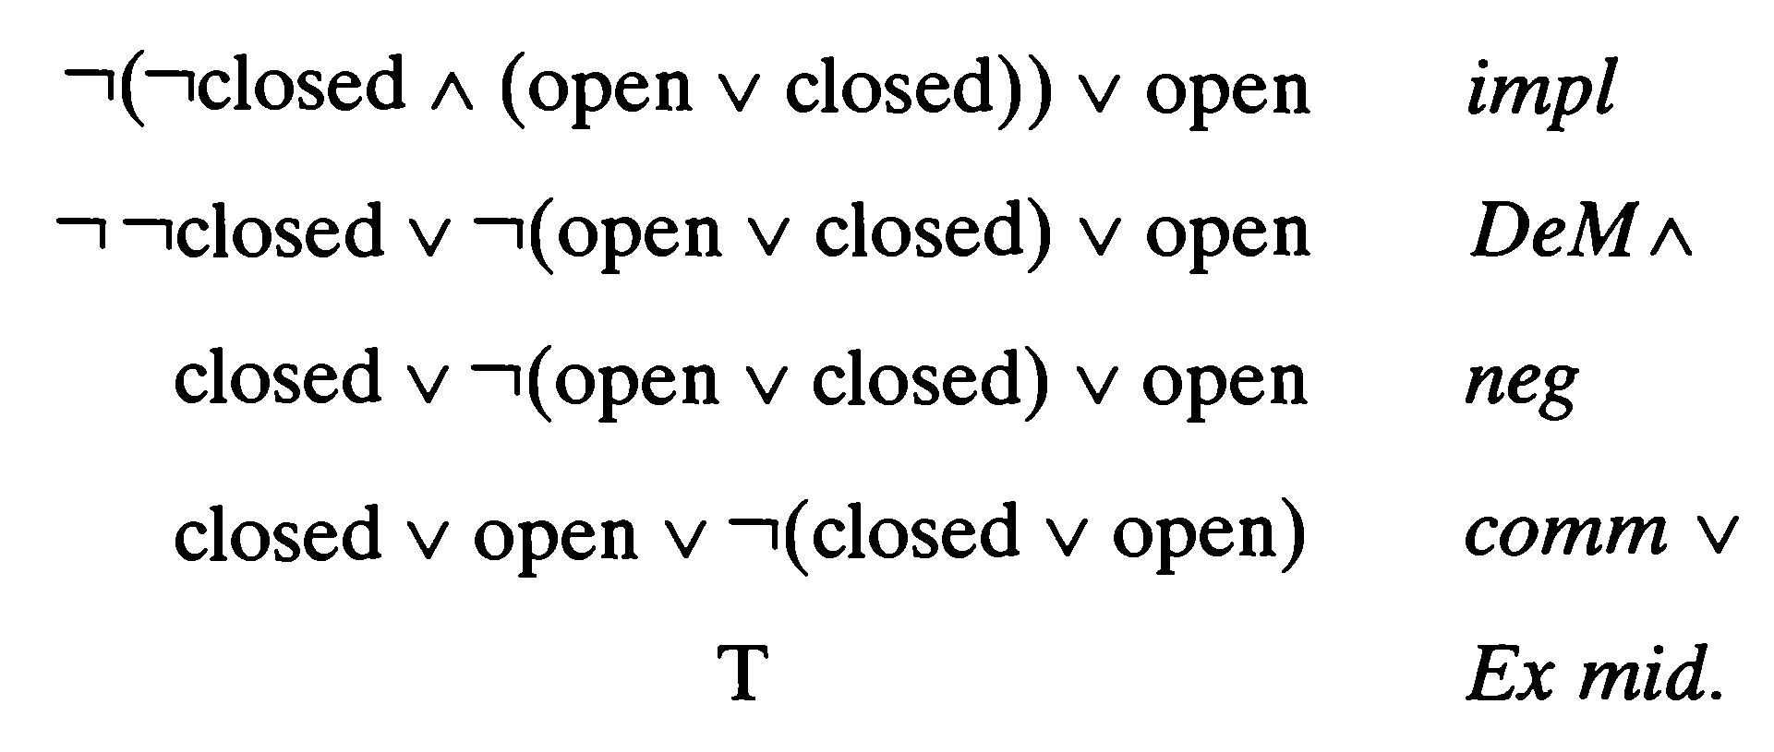
Solution

Slide 35
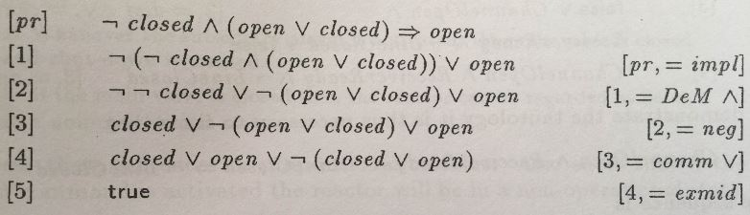
Alternatively:

Slide 36
Indirect proof or proof by contradiction
The way to proceed is to assume that Conclusion has a False value and that each P and S has a True value and analyze the consequence of an assignment of these values to the individual propositions that make up each P and S.
Such an analysis may lead to a contradiction; if it does, then this shows that Conclusion can be deduced from P1, P2, . . . , Pn using S1, S2, • • • , Sm.
However, if all the assumptions are satisfied and consistent, then it has been demonstrated that Conclusion cannot be deduced from P1, P2, . . . , Pn and S1, S2, . . . , Sm.

Slide 37
Example
1. Whenever the system is in startup mode, all peripherals are closed down and, whenever the system is in functioning mode, then all peripherals are operating normally.
2. If all the peripherals are closed down and all peripherals are operating normally, then the system is in an inconsistent state.
3. The system can never be in an inconsistent state.
If the conclusion to be proved is that; either the systems is in startup mode or not in functioning mode then:

Slide 38
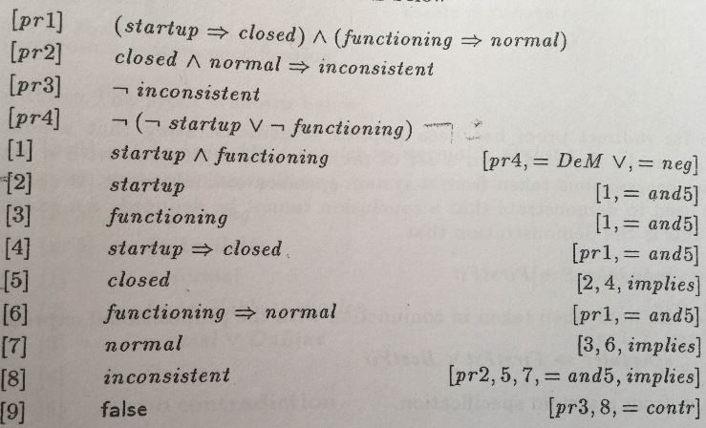
Solution
[Negation of conclusion]

Slide 39
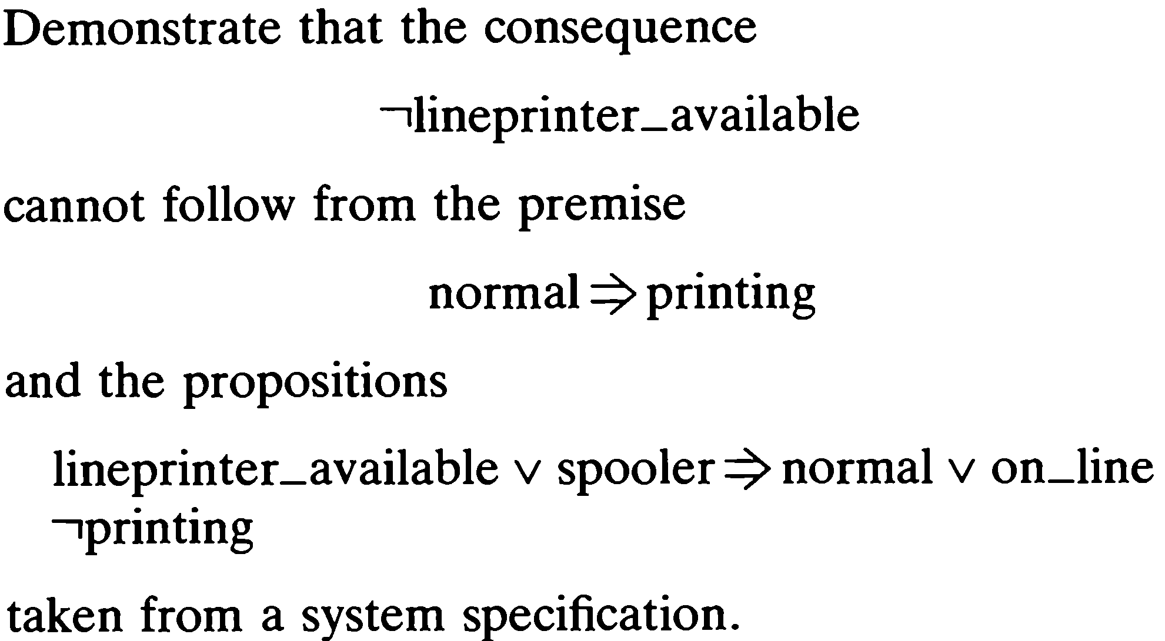
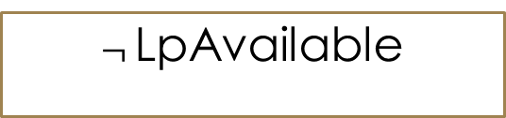
Example
$¬$LpAvailable
LpAvailable

Slide 40
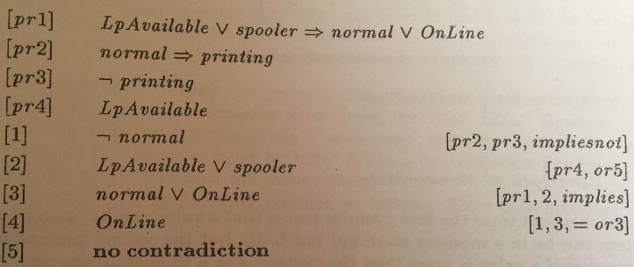
Solution

Slide 41
Detection of inconsistencies
A series of propositional expressions are consistent, if and only if, there exists at least one assignment of truth values for the variables in each propositional expression such that all the expressions simultaneously receive the value T.
Inconsistency is the reverse of this. A series of propositional expressions are inconsistent, if and only if, every assignment of truth values to the variables making up each propositional expression results in at least one expression receiving the value F.

Slide 42
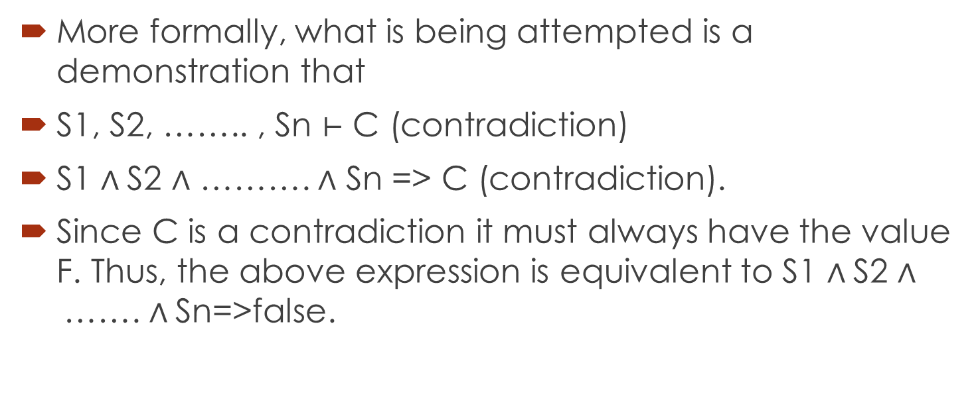
More formally, what is being attempted is a demonstration that
S1, S2, …….. , Sn $⊢$ C (contradiction)
S1 $∧$S2 $∧$ ………. $∧$ Sn => C (contradiction).
Since C is a contradiction it must always have the value F. Thus, the above expression is equivalent to S1 $∧$S2 $∧$……. $∧$Sn=>false.

Slide 43
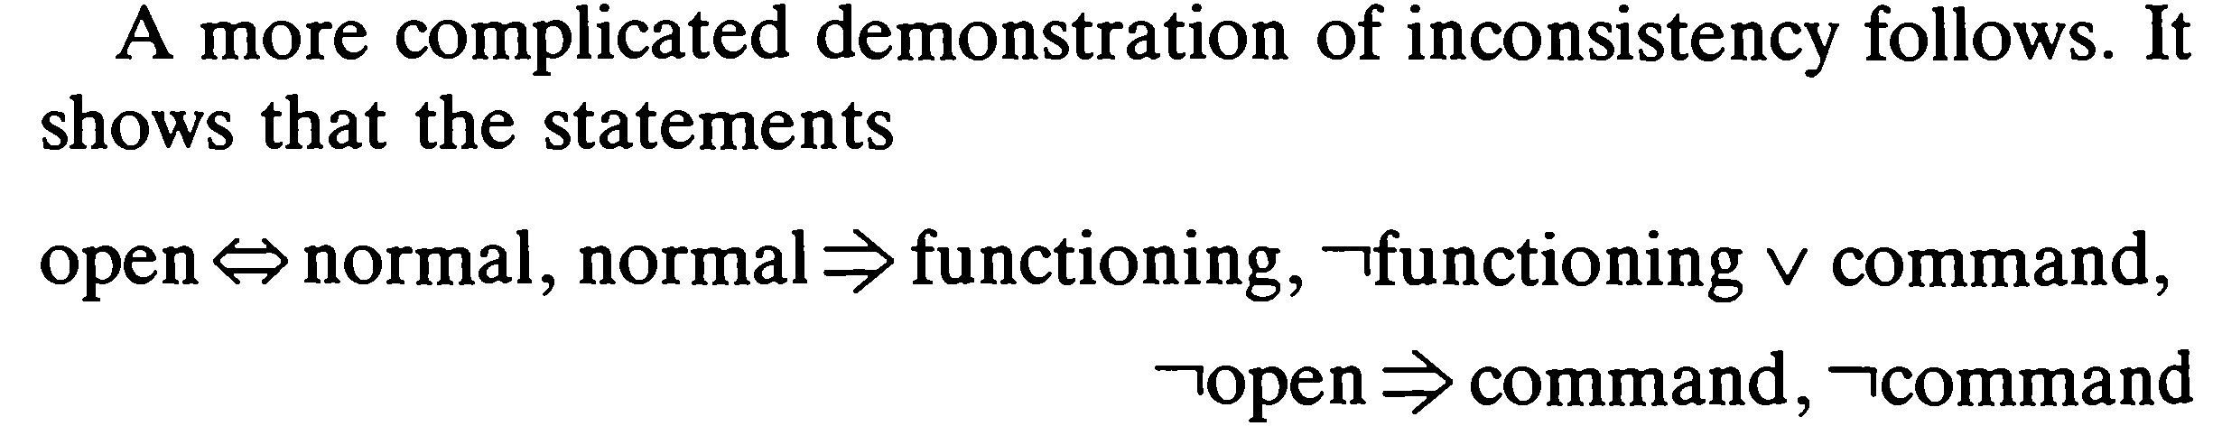
Detection of inconsistency: demonstration

Slide 44
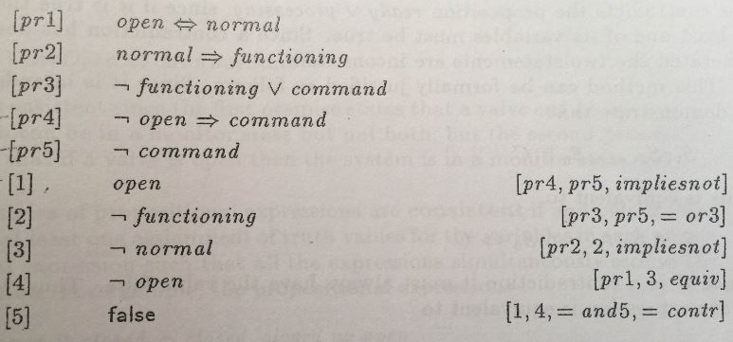
Solution: inconsistency detected

Slide 45




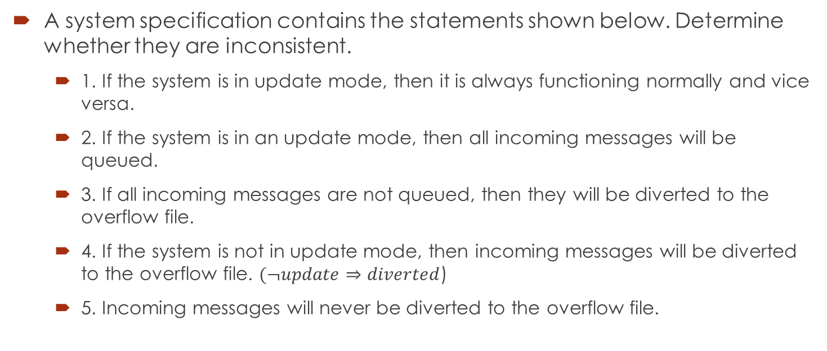
Example
A system specification contains the statements shown below. Determine whether they are inconsistent.
1. If the system is in update mode, then it is always functioning normally and vice versa.
2. If the system is in an update mode, then all incoming messages will be queued.
3. If all incoming messages are not queued, then they will be diverted to the overflow file.
4. If the system is not in update mode, then incoming messages will be diverted to the overflow file. $(¬update⇒diverted$)
5. Incoming messages will never be diverted to the overflow file.

Slide 46
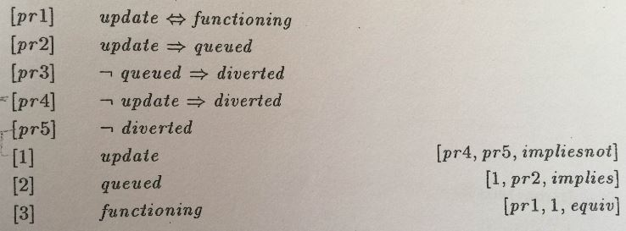
Solution: no inconsistency detected

